Slide 1
MLAB SMS/USSD PRESENTATION

Slide 2
Why USSD/SMS for this project?
Realtime
Interactive
Menu driven
Fact
1.As at February 2011 they 17 million active users.
2.Currently Safaricom has 19.9million MPesa users only 3million use smartphones.
3.Deposits ksh.87 billion an withdrawals ksh.75 billion.
http://www.safaricom.co.ke/mpesa_timeline/timeline.html

Slide 3
SAMPLE BUSINESS CASE – CAFÉ HOUSE
How can a café House business owner use USSD and SMS to enhance his business?
1.Use the application to market product.
2.Send out message and reach out to customer.
3.Use of loyalty points

Slide 4
Revenue Model
Making money using USSD/SMS application
Premium billing for the USSD session.

Slide 5
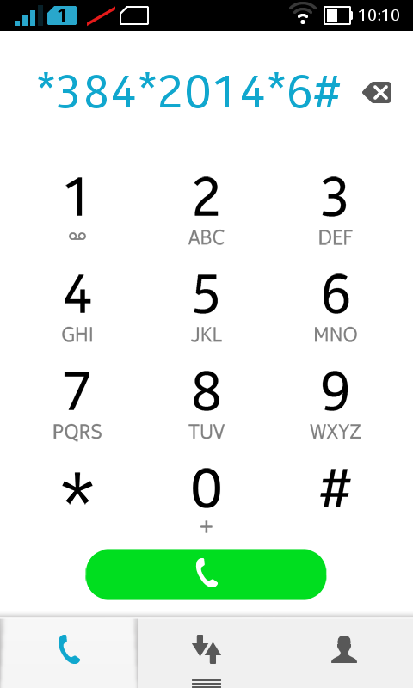
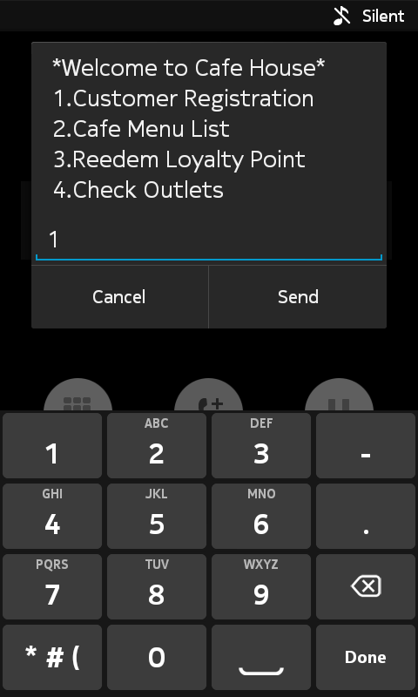
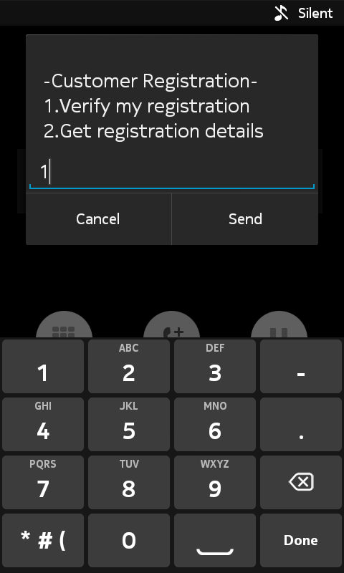
USSD SESSION
Service code
Main Menu
Registration

Slide 6
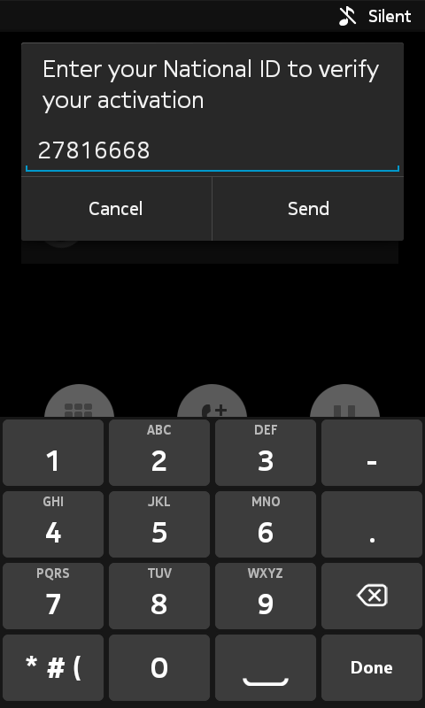
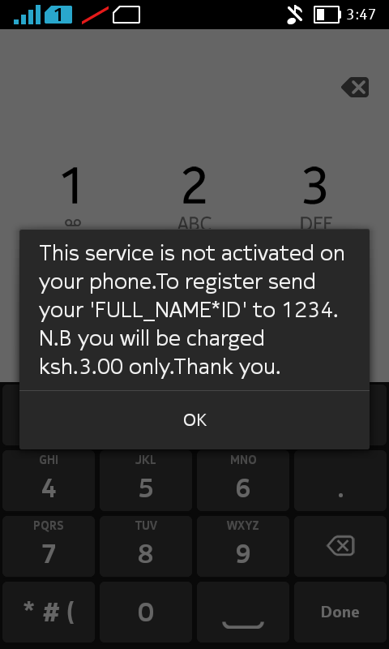
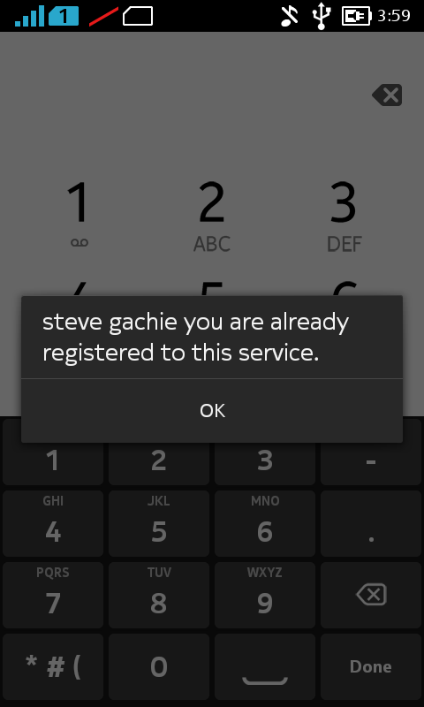
USSD SESSION
ID validation
Not Registered
Registered

Slide 7
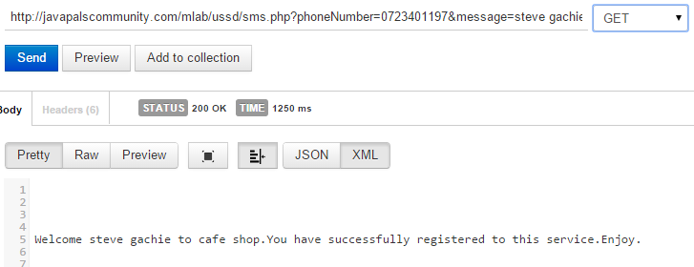
SMS Registration

Slide 8
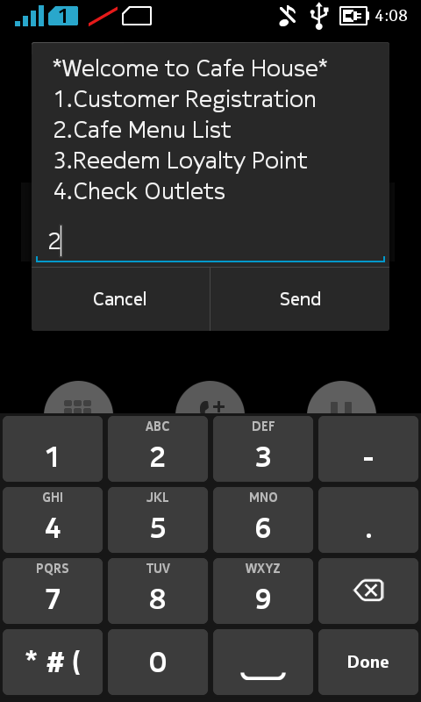
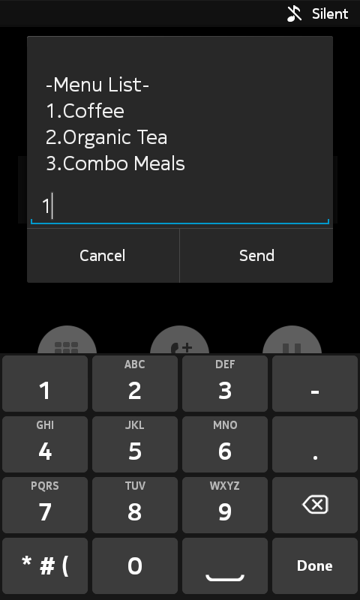
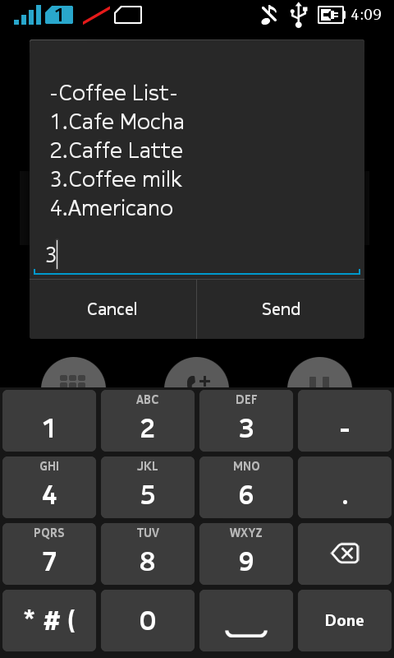
MENU LIST
Main list
Menu list
Coffee List

Slide 9
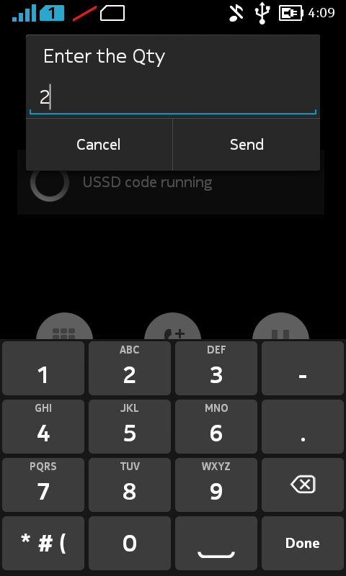
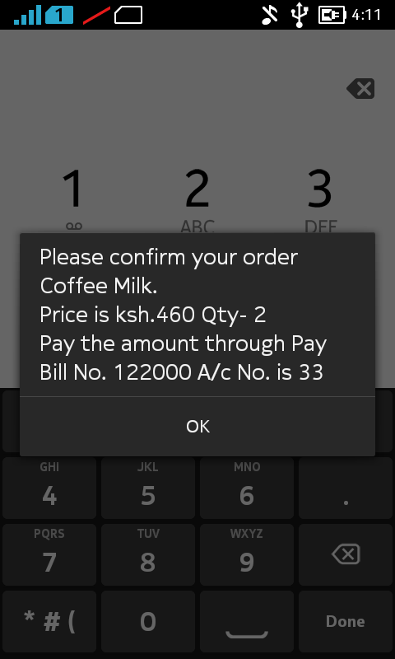
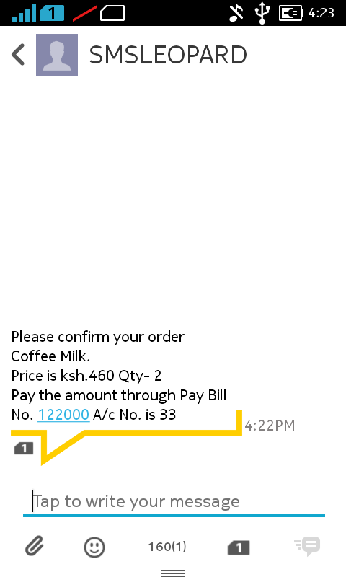
Buy Coffee for My date and Me
Qty of product
Response USSD
Response SMS

Slide 10
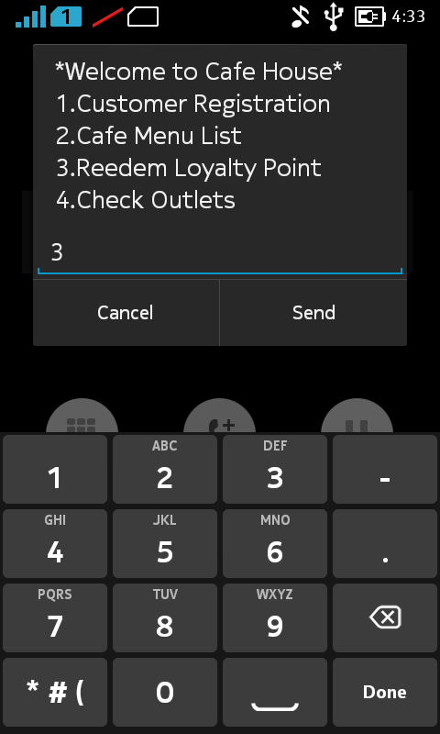
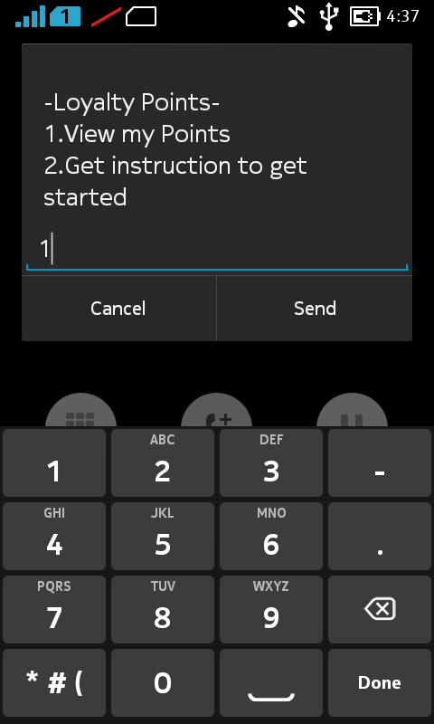
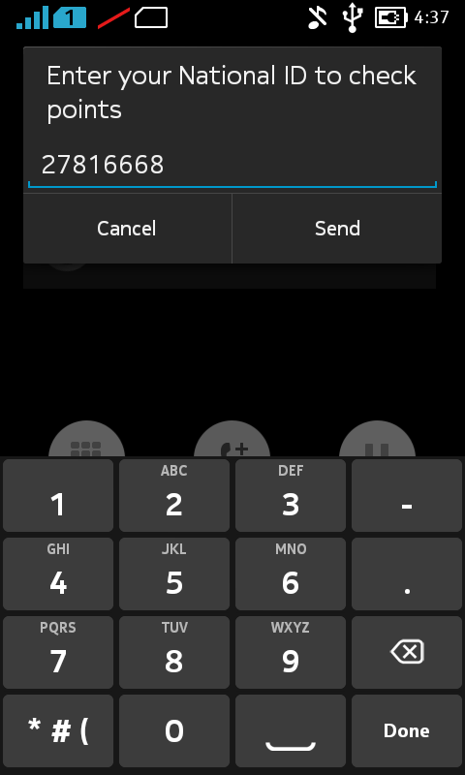
Checking for points

Slide 11
Problems
1.Convinence.
2.Difficulty in marketing.

Slide 12
Benefits of using this application
Buy a meal or beverage and check-in at the café any time of the day ,week or month.
Points are given to customer that register and buy using application.

Slide 13
Target Market
All users with a phone both smartphone and feature phone and have an MPESA account .
Users with busy lifestyle that buy coffee at free times.

Slide 14
Target Subsidiaries companies in Kenya
1.ColdStone Creameries
2.Subway
3.Java
4.Steers
5.Debonairs
6.KFC

Slide 15
Code *384*2014*6# id number 27816668 github stevexdev

Slide 16
THE END

